Slide 1
Interactive Sketch-based Method for Generating Realistic Cloth Graphics from 3D Model
Tokyo Institute of Technology, School of Computing
Saito Laboratory
18M38311
Zheng Yufei
Notes:
For all the listeners good morning, I am Yufei Zheng from Saito Laboratory. This is the title of my presentation today.

Slide 2
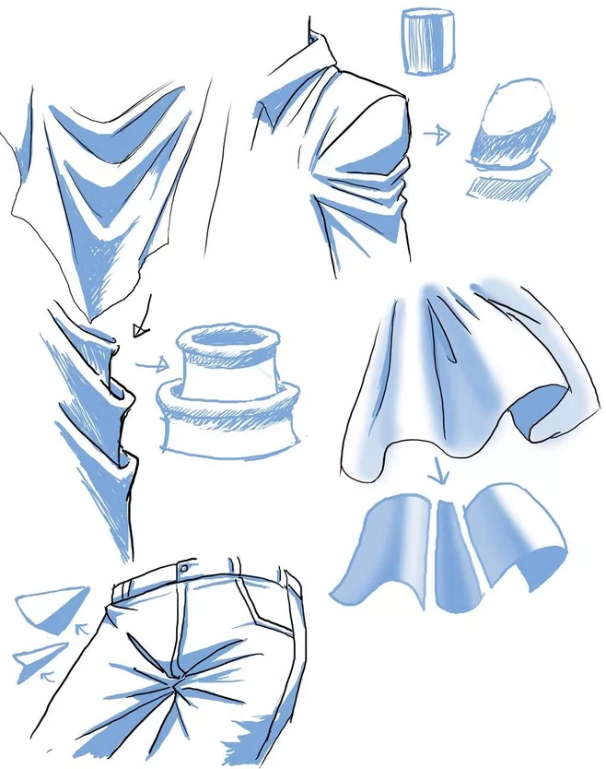
Research Background
Folds is the most important thing to express the unique of cloth.
For the beginner, it is difficult to hold the correct physical expression when drawing folds on the cloth.
Force condition
Light condition
Feature of the fabric quality
Sewing structure of cloth
Notes:
At first, let me introduce the research background. Cloth is a very important part of the figure paintings, and the folds on the cloth are the most intuitive part to express the texture and effect of it. But for beginners, it is very difficult to hold the correct physical expression of the folds that based on the force condition and the feature of the fabric quality, and it is also hard to draw the correct folds shading according to the light. Not only that, but drawing the correct folds also requires good understanding of the cloth’s sewing structure. Therefore, I hope to implement a system that can help people draw the picture of cloth with realistic folds and provide them with reference image.

Slide 3
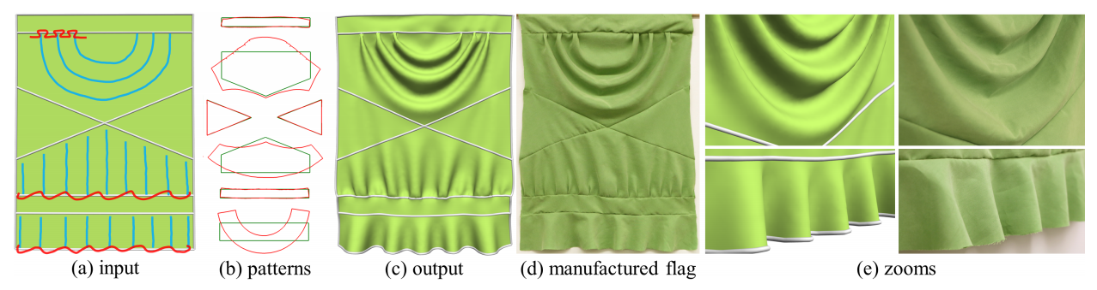
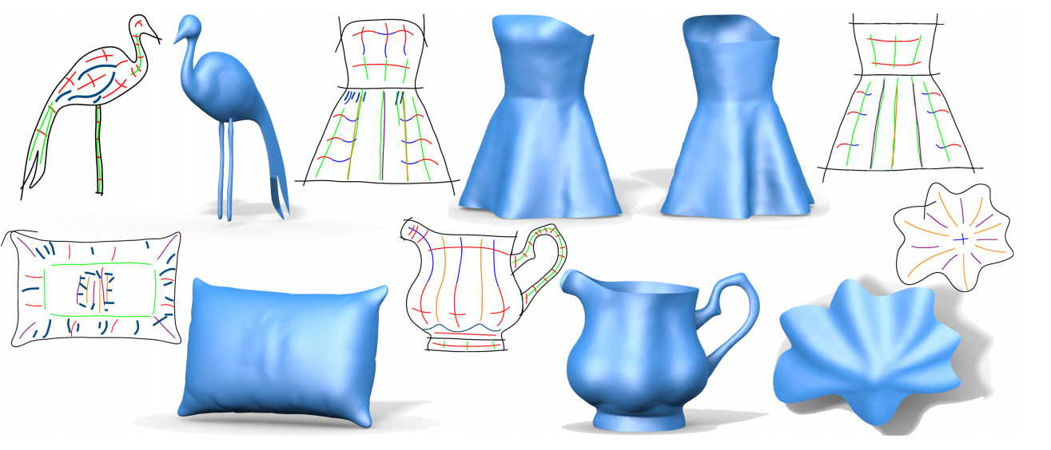
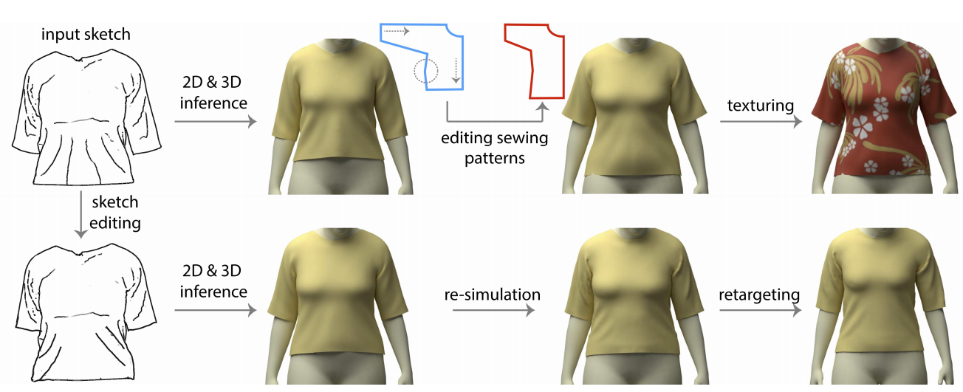
Related Works
Foldsketch: Sketch directly on the model then get the result.
Limited to the areas that can be drawn and the folds’ shapes.
Minchen Li, Alla Sheffer, Eitan Grinspun, and Nicholas Vining. Foldsketch: Enriching garments with physically reproducible folds. ACM Transaction on Graphics, 37(4), 2018.
Changjian Li, Hao Pan, Yang Liu, Xin Tong, Alla Sheffer, and Wenping Wang. Bendsketch: Modeling freeform surfaces through 2d sketching. ACMTrans. Graph., 36(4):125:1–125:14, July 2017.
Tuanfeng Y. Wang, Duygu Ceylan, Jovan Popovi´ c, and Niloy J. Mitra. Learning a shared shape space for multimodal garment design. In SIGGRAPH Asia 2018 Technical Papers, SIGGRAPH Asia ’18, pages 203:1–203:13, New York, NY, USA, 2018. ACM.
Bendsketch: Get the whole model directly by sketching.
Based on machine learning.
Enough knowledge of pattern structure and drawing is required.
Only can generate the model of cloth that the style is already existing in the database.
Notes:
In fact, currently most of those systems for interactively generating folds are focusing on generating 3D models rather than just getting a single 2D cloth image. Such systems have a high demand for user expertise, and there are also many limitations on the location and shape of the generated folds.
Some machine learning based method only can generate the model of cloth that the style is already existing in the database.

Slide 4
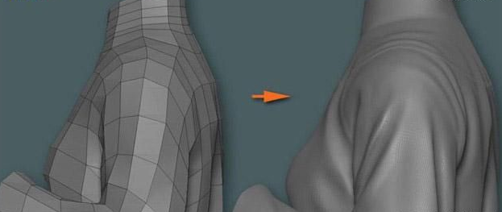
Research Purpose
An interactive system for generating cloth images by directly sketching on the cloth model to make folds based on real cloth photos or user needs.
http://style.moonbasa.com/chaoliuqushi/1181.html
1 Easy to use, convenient for beginners, requires little expertise
2 Provides basic physical simulation systems, including spring force, gravity, friction, support forces, and wind.
3 The style and the position of the folds are basically unrestricted
http://www.zf3d.com/news.asp?Id=15487
Ideal result
Notes:
Depend on the problems I mentioned, my research purpose is to design and implement an interactive system for generating cloth images by sketching on the cloth model to make folds based on real cloth photos or user needs.
This system must to be easy to use, which is convenient for the beginners that don’t hold enough expertise.
In order to show the shape of the folds more realistically, the system will also provide a basic physical simulation systems, including spring force, gravity, friction, support force, and wind. The user can change the parameters of these forces interactively. And in order to be able to adapt to different situations, the style and the position of the folds are basically unrestricted, the user can be free to adjust them.
As shown in the image below, the red lines do not represent the boundary line of the folds in the meaning of painting, but refers to the trend and position of the fold. I hope my system can generate the folds image as the user wants as much as possible just according to these simple lines.

Slide 5
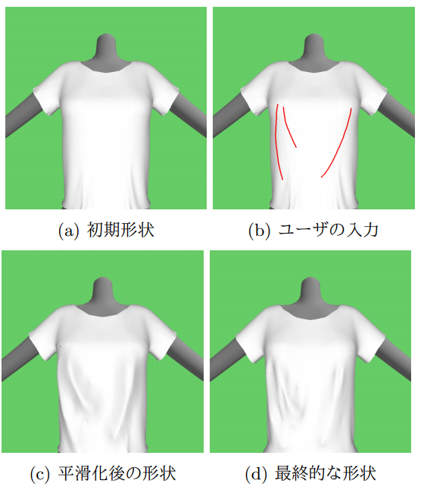
Related Works
Input models
Preprocessing
Modification of the initial state
Sketching on the model
Mesh Reconstruction
Smoothing
Modifying and get the result
Modification of the final state
Hatsu Shi, Suguru Saito,``An interactive method for adding wrinkles on cloth models to generate a convincing cloth CG'',proceedings of the 81st National Convention of IPSJ, 2ZC-03, 2 pages, IPSJ, 2019.
Notes:
Then I will introduce Shi’s work. This sketch-based method is focusing on making realistic cloth images. His method gave me an idea for generating folds images in a simple way. Users can preprocess the input clothing model through the physical simulation system based on a improved Provot’s mass-spring system, then directly draw curves on the cloth model to generate folded surface, and finally adjust the folds through smoothing method and the physical simulation system again. Different from the previous related works, Shi’s work only focuses on the generation of a single folds 2D image instead of a 3D cloth model, so the height of the folds is not controllable, and the generated folded surface model will become unreal once rotated.

Slide 6
Research Purpose - Based on Shi’s work
My work:
1. Introduce remeshing methods to improve the folds quality in the step (c).
2. Implement a local parameter update algorithm in step (d) to keep the shape of folds in physical simulation.
3. Provide more physics conditions in step (d).
4. Implement a fully functional user interface.
The problems in the process of generating folded surfaces and improve the quality of the results in steps (c) and (d) in Shi’s system:
The resulting folds have single shape that cannot be adjusted.
- Add algorithms that can interactively modify the shape of the folds in real time.
The physical simulation environment is too single and the results are unstable.
- Provide various physics conditions, and improve the stability of the generated folding surface according to a new algorithm.
Bad UI design, hard to use.
- Implement fully functional user interface with good appearance.
Hatsu Shi, Suguru Saito,``An interactive method for adding wrinkles on cloth models to generate a convincing cloth CG'',proceedings of the 81st National Convention of IPSJ, 2ZC-03, 2 pages, IPSJ, 2019.
Notes:
So this time my research purpose and main goal is to solve the problems in the process of generating folded surfaces and improve the quality of the results on the steps c and d in Shi’s system .
Shi only provides a simple mesh reconstruction method to generate folded surface based on input curves, which cannot adjust folds’ shape and are not realistic most of the time. So I am going to add a local remeshing algorithms that can interactively modify the shape of the folds in real time. It can be seen from c and d in the figure on the left that the shape of folds generated by Shi’s method will change greatly or even disappear after physical simulation, and Shi only provides a very single physical simulation environment in which parameters cannot be adjusted. So I decide to update it by adding various parameter-controllable physical simulation conditions, and improve the stability of the generated folding surface according to some new algorithms. In addition, the UI of Shi is very simple and hard to use, so I also implement a fully functional UI interface with good appearance.

Slide 7
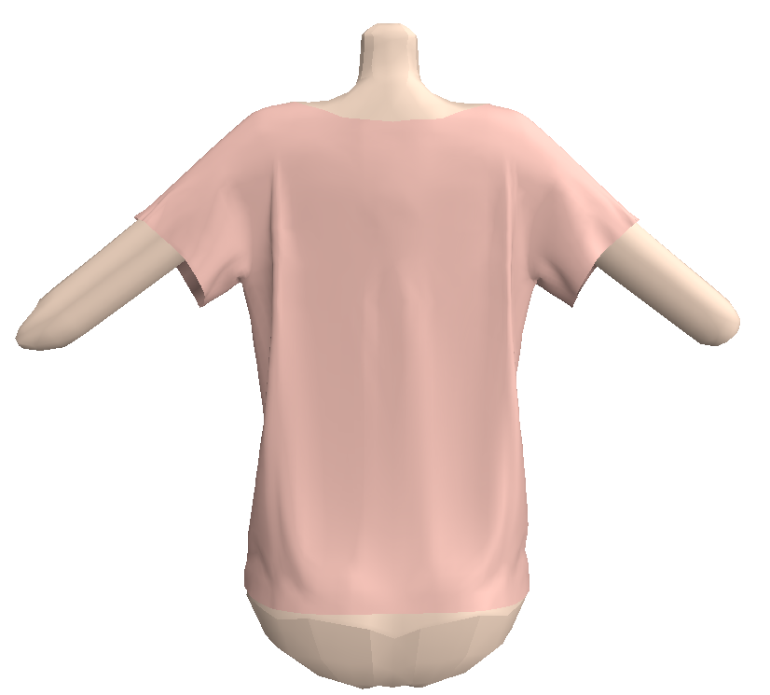
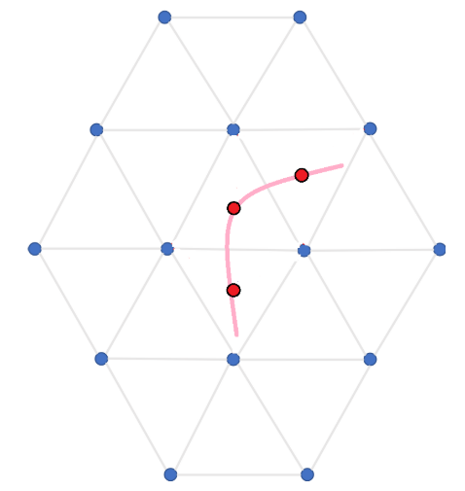
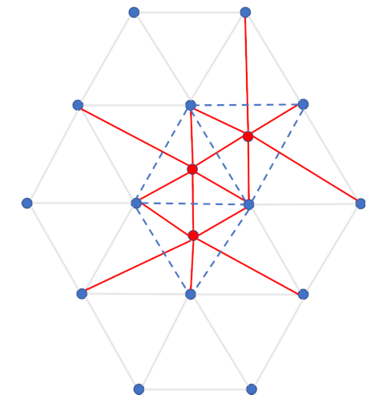
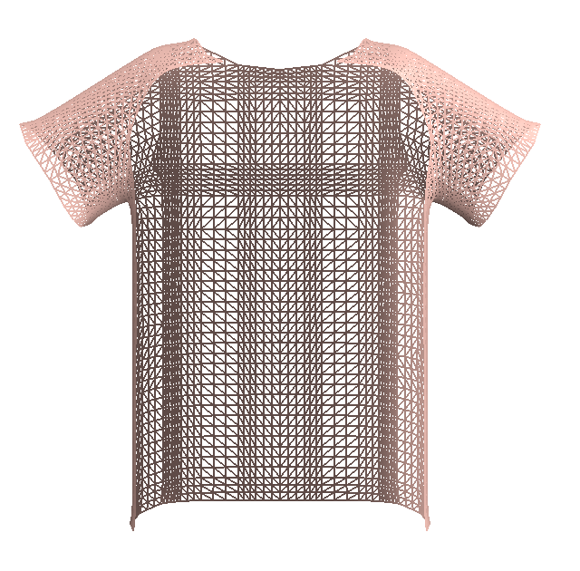
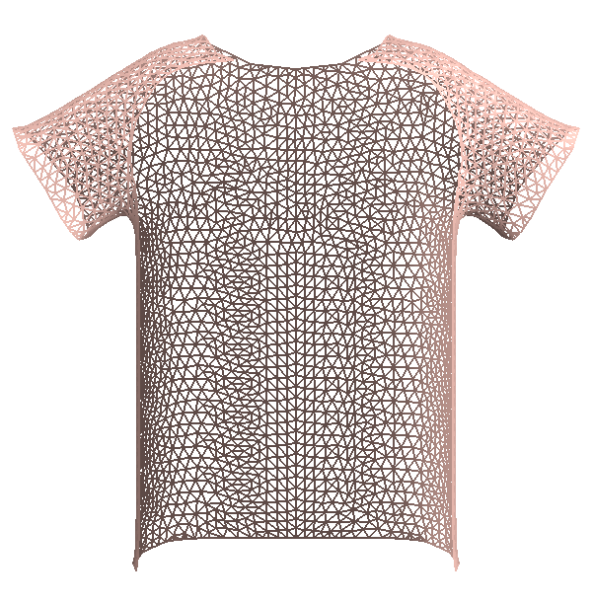
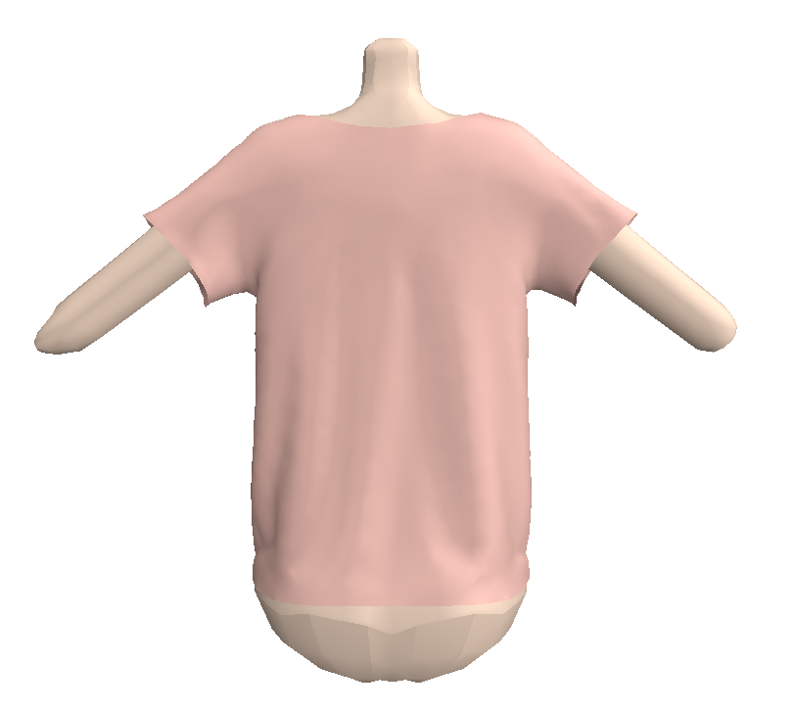
Proposed Method – Remeshing & Folds shape customize
Local remeshing to change shape of folded surface
Folds shape customize
Result with/without global remeshing
Local remeshing method: (Doing implementation now)
Add control points on the grid and provide users with tools to move them, making the shape of the generated folded surface controllable.
Global remeshing method:
Optimize cloth model’s grid structure to make the physical simulation result better
Notes:
The first new feature I added is remeshing method, which included global remeshing method and local remeshing method. The global remeshing is used before applying the physical simulation. In these two comparisons we can see that global remeshing can help to optimize the grid structure to make physical simulation result looks better. After the global remeshing, some unexpected folds will disappear, the shape of other folds will also be more gently.
The next one is local remeshing method, which is under implemented currently. In Shi's method, he can only make a sharp mountain and then do the constraint smoothing operation to obtain the folded surface model, but this will make the shape of the folds uncontrollable and often contrary to the user's idea.
So based on the reconstructed grid structure made by Shi’s algorithm, I will add some control points on the grid and provide users with tools to move them, making the shape of the generated folded surface controllable. Those control points will added on all the dark blue triangles that connect the user input new points and the surrounded points. By moving the control points, the user can create a soft or hard folds in different shapes.

Slide 8
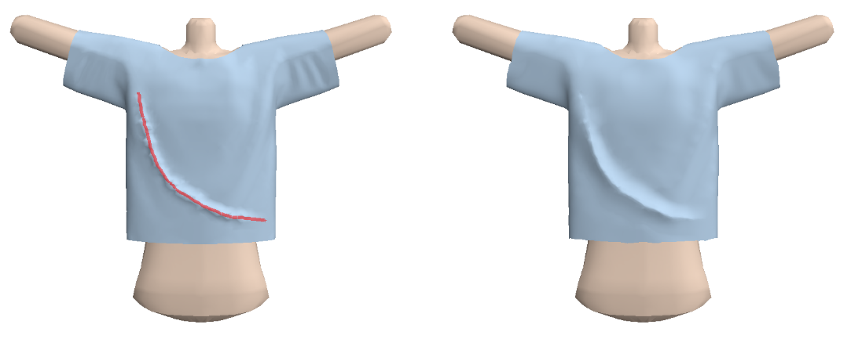
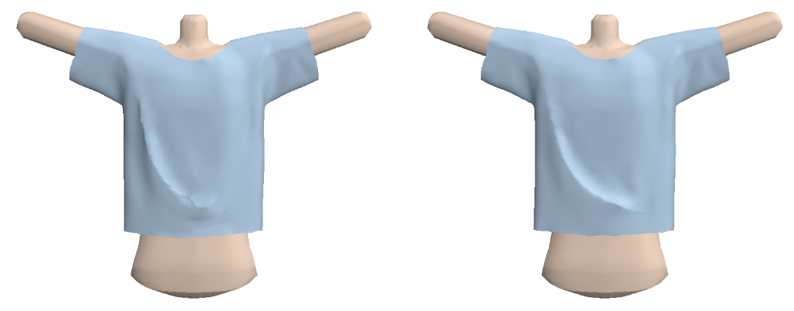
Proposed Method - Physical simulation system upgrade
Without constraints
With constraints
Spring parameter’s constraints on user input curves:
Limit the parameters of the spring structures on the folded surface generated based on the user input curves to avoid the shape of these folds changing too much or disappearing directly after the physical simulation.
Notes:
I proposed a solution to the problem that the fold shape will disappear after physical simulation in Shi's method because of the overstretch of the surface. Provot's spring system, which is also the basic related works in my system, has an algorithm for controlling the overstretch of the surface after physical simulation. It sets a maximum elongation factor for each spring. If the spring overstretch too much that go through this factor, it will return shorter in the opposite direction. Based on this idea, I changed the maximum elongation factor of the spring structures on the newly added folded surface locally, and enhanced the spring k-value of them. This operation can help avoid the shape of these folds changing too much or disappearing directly after the physical simulation. The upper two figures show the user input curve and the folded surface generated by it. The figure at the bottom left shows the physical simulation result without constraints, this folded surface tend to be disappear and the shape at the bottom of it can’t be kept. But the figure at the bottom right, which shows the result with constraints, can keep the shape in a degree.

Slide 9
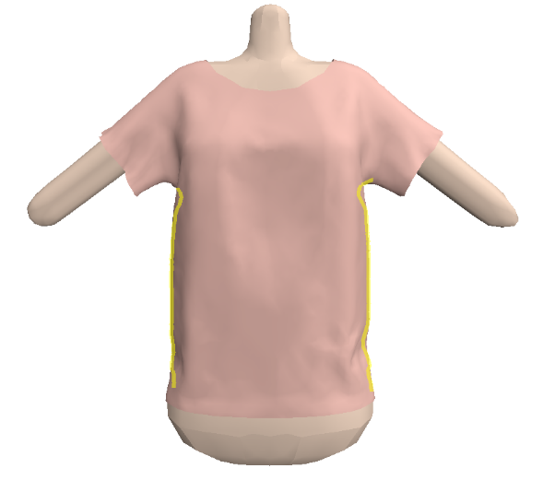
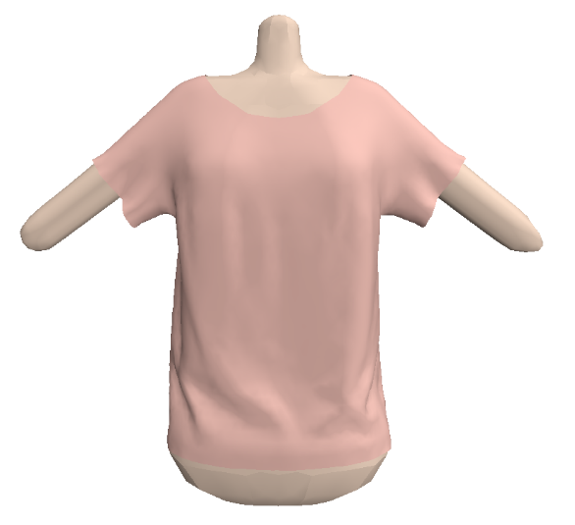
Proposed Method - Physical simulation system upgrade
Yellow curves: sewing lines
Sketch-based sewing lines input:
Use the same idea as local spring parameter’s constraints to produce the effect of local folds accumulation.
Notes:
The clothing model input by the user sometimes exists as a whole without local segmentation, which will make the physical simulation result unreal. The operation of adding sewing lines can further improve the quality of folds. But the traditional method of adding sewing pattern lines in some modeling software is hard to use and need enough expertise of the structure of cloth. So this time, using the same idea as local spring parameter’s constraints, I also provide a interactively sketch-based method of inputting sewing lines that can help to produce the effect of local folds accumulation.

Slide 10
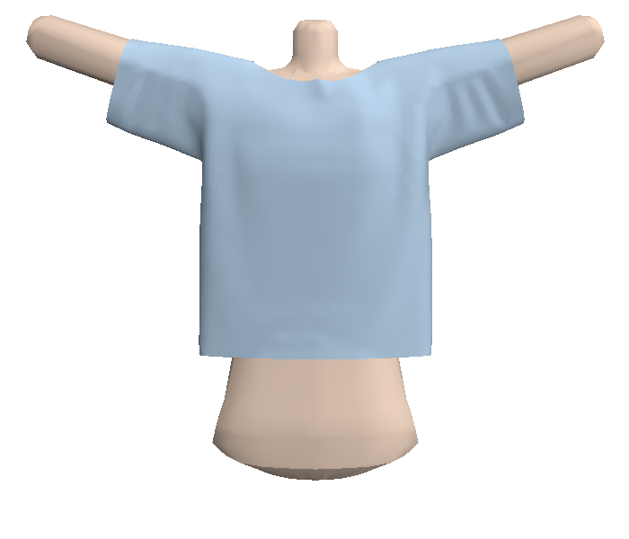
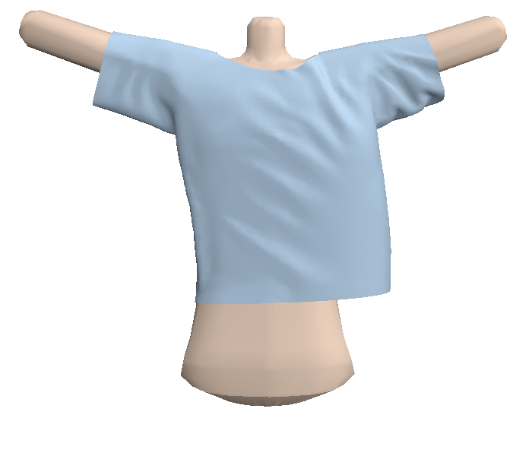
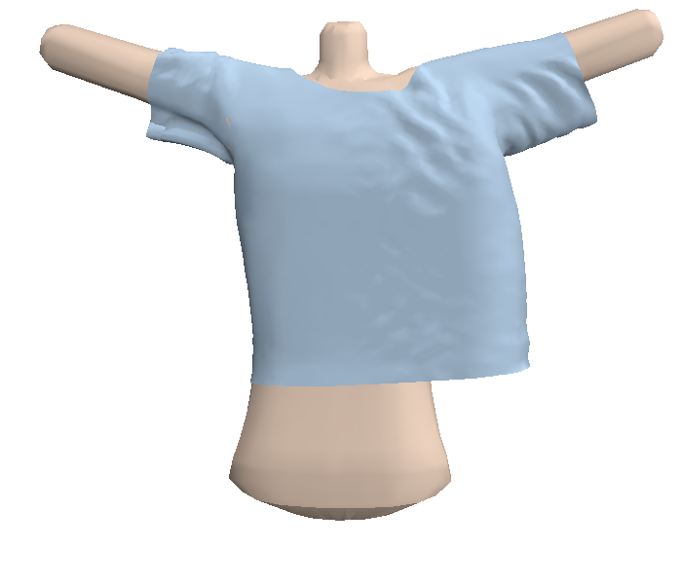
Proposed Method - Physical simulation system upgrade
0 m/s
5 m/s
18 m/s
Various physics conditions: (Doing implementation now)
Introduce more systems of external forces other than gravity, currently is wind system.
In the future: Character movements include jumping, spinning, etc.
Need to improve the fit with folded surface based on user input
Notes:
And the last part is to introduce various physics conditions for physical simulation system including some external forces. Currently I have implemented the wind system. The user can change the parameters of wind, like the strength and the direction. In the future, I would like to implement the character movements like jumping, spinning and so on. But at this time the result of combining external force system and user input folded surface is not so well. So I also need to improve the fit of them.

Slide 11
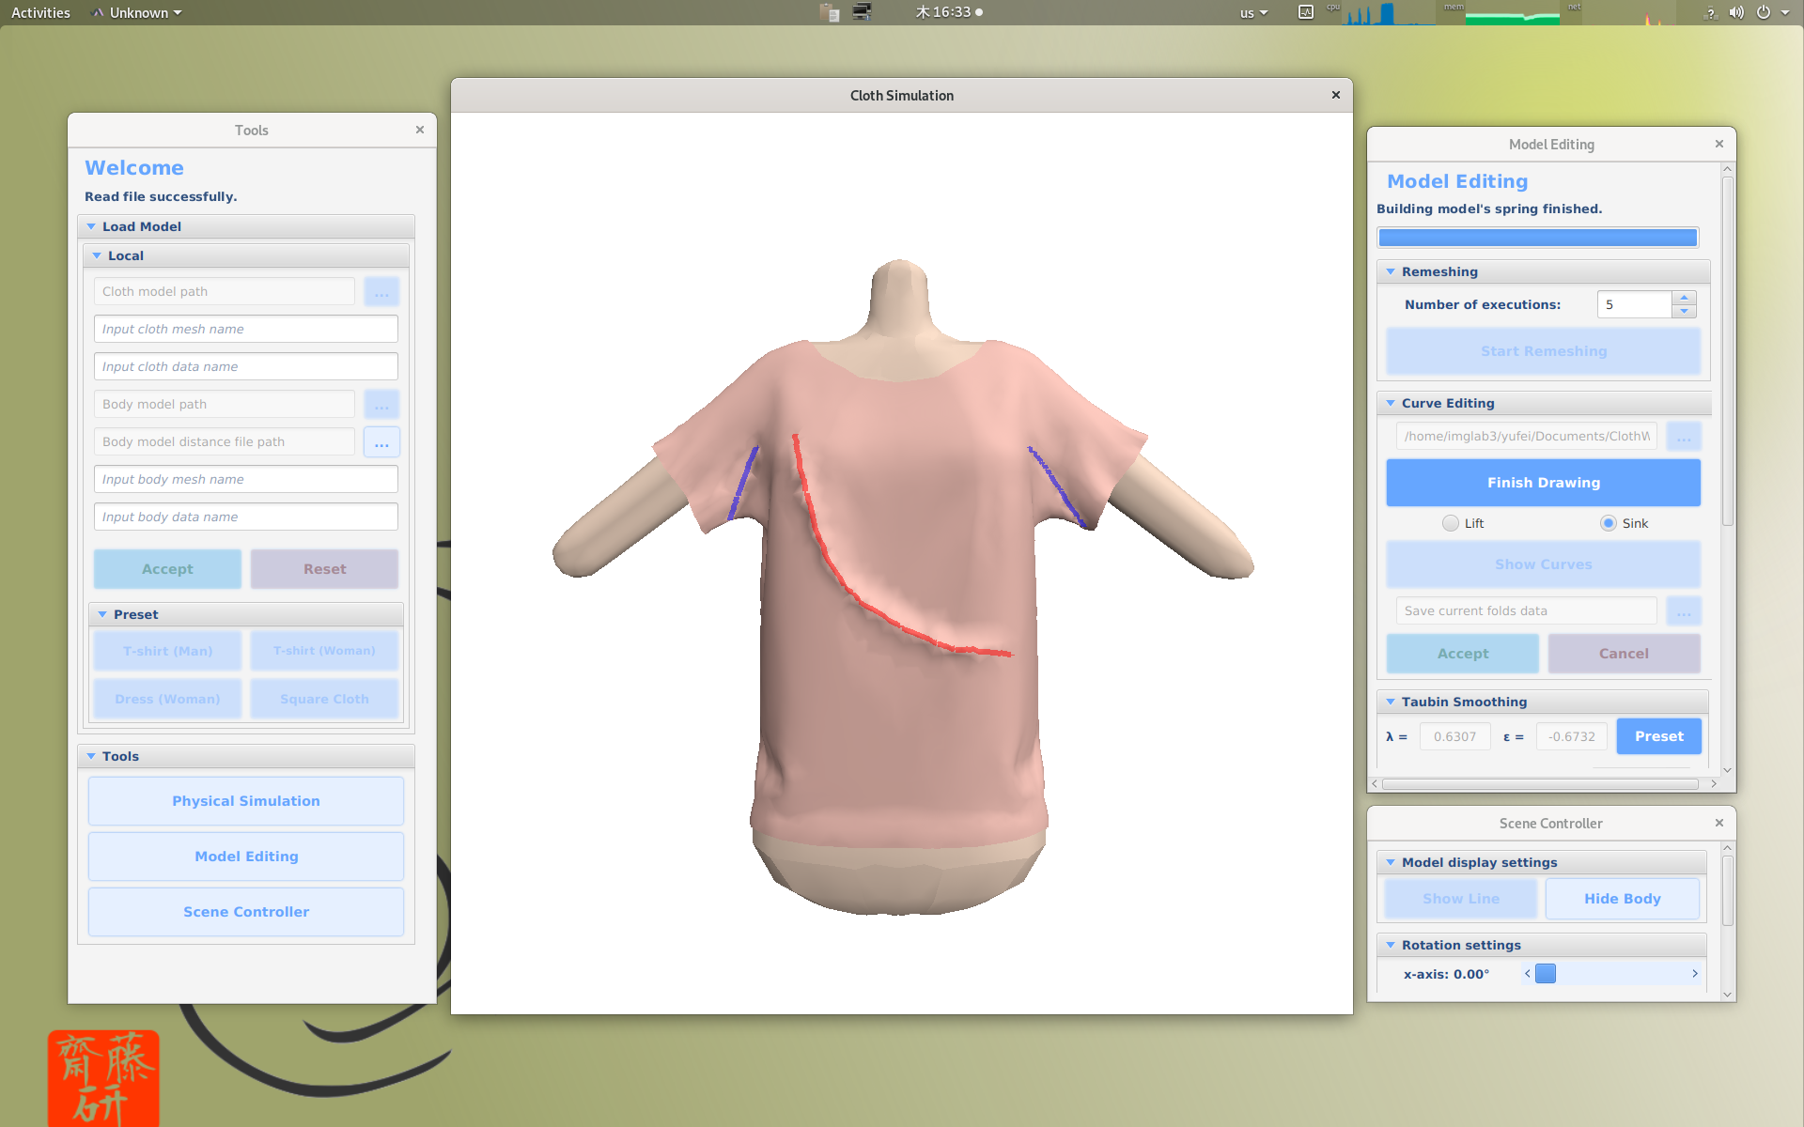
User Interface
Notes:
In addition, in order to let my system easier to use, I have made a user interface based on JavaFX. The user can select different tools on the sub windows, and draw the curves on the cloth model in the main window to make the folded surface. As the functionality increases, I will continue to update and improve my user interface in the future.

Slide 12

Evaluation
？
Evaluation: (Doing testing now)
Impossible to evaluate it by numerical criteria.
Make the evaluation by compare the result image with real cloth photos
Notes:
Since the results of my method vary from person to person, it is impossible to evaluate it by numerical criteria. So I decide to make the evaluation by compare the result with real cloth photos.

Slide 13
Section Composition of Master’s Thesis
1 Introduction
2 Related works
3 Grid reconstruction
1 Remeshing
2 Folded surface shape reconstruction (Future work)
4 Physical simulation system upgrade
1 Spring parameters update
2 External force system (Future work)
5 Results and evaluation (Future work)
6 Conclusion
Notes:
Here is the simple section composition of my master’s thesis. I will separate it into six sections: Introduction, Related works, Grid reconstruction, Physical simulation system upgrade, Results and evaluation, and Conclusion part. The part marked Future work indicates that it is not complete yet.

Slide 14
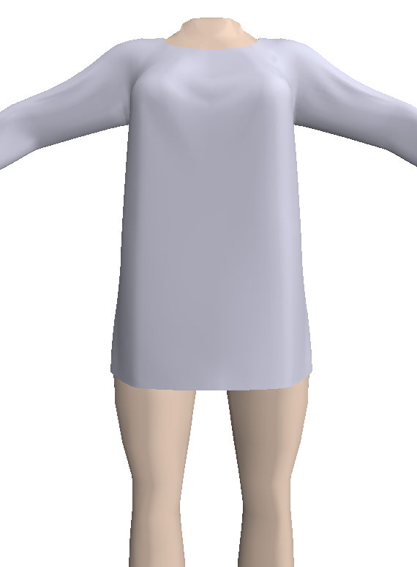
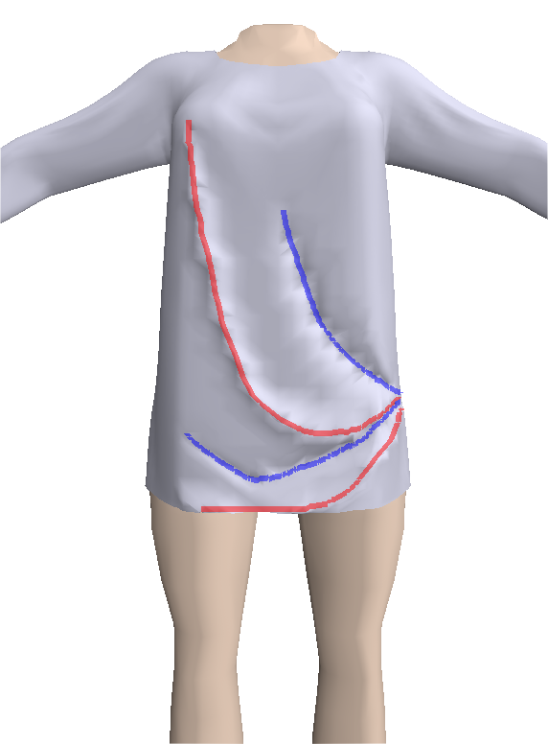
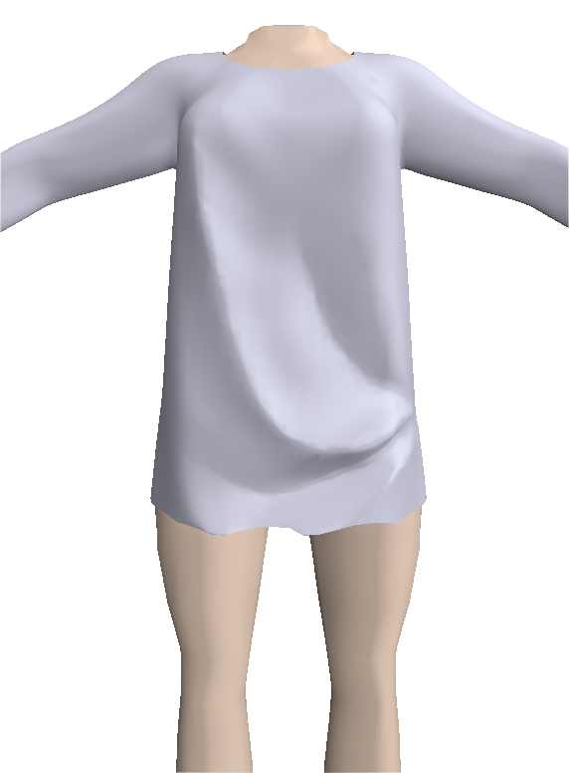
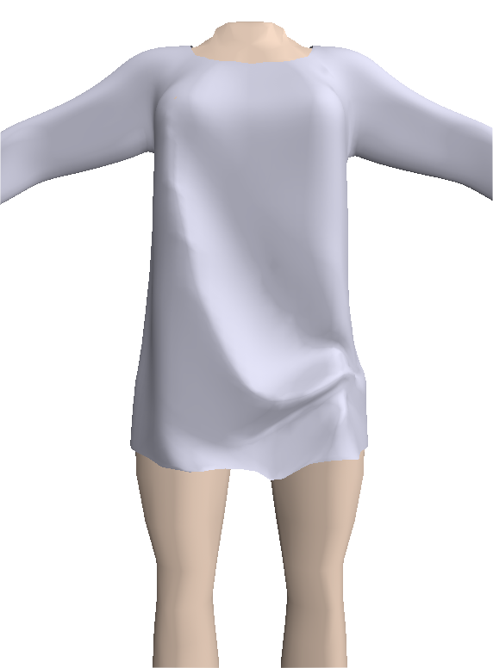
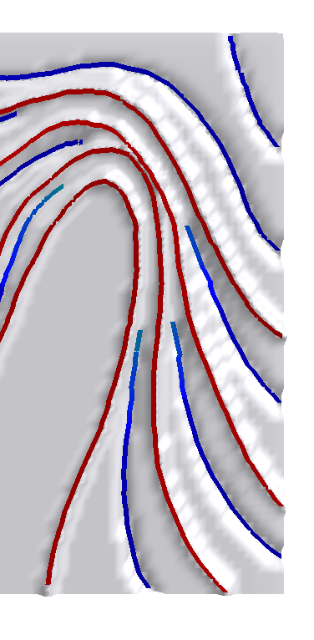
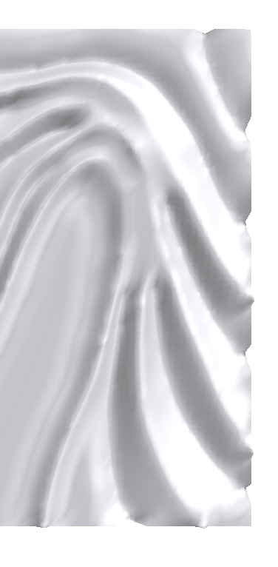
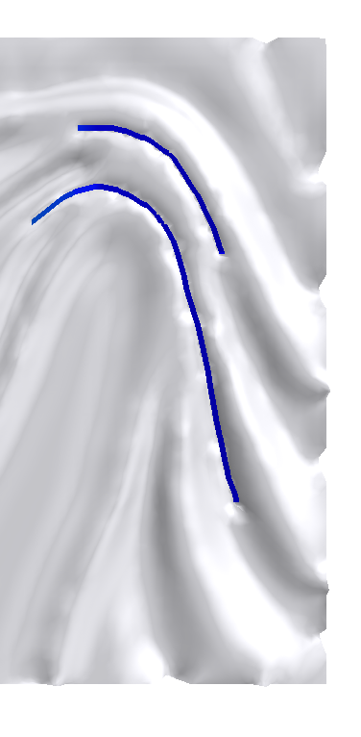
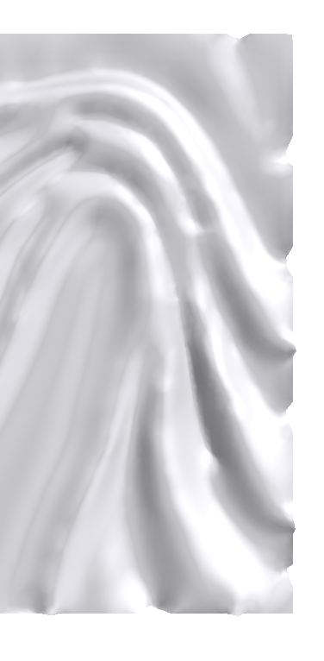
Conclusion and Future Work
The paper on the previous work with Shi has been accepted in this year's Cyberworlds 2019 as full paper.
Evaluation: Compared with real cloth images.
Preparing another two submissions.
Implement the new algorithms and tools I plan to do one by one.
Notes:
Here are some example of the results of current system. The paper on my previous work with Shi has been published in last year's Cyberworlds 2019 as full paper, and I am also working on preparing another two submissions for my current work this year. In the future, the most important things for me is to implement the new algorithms and tools I plan to do one by one.
This is the end of my presentation, thank you for your listening.

